Slide 1

Securing Your API Endpoints A practical guide to API authentication
@spetryjohnson
Notes:
Welcome to "Securing Your API Endpoints!"
This is one of my favorite talks to give and I'm excited to share it with you. Over the next hour I'm going to take you on a journey of discovery, at the conclusion of which you'll leave this room a bit wiser and a bit more knowledgeable than you are right now.

Slide 2

My rookie mistake
Notes:
Our journey begins with a confession. A few years ago, I made a huge rookie mistake.
I was writing a feature and I wanted a piece of JavaScript to make an API call back to my server. Unfortunately, as it turns out RESTful APIs are normally stateless, so I couldn't rely on the server just automagically knowing which user account was attached to the API call. I obviously needed to do something extra in order to add authentication to that API call.
Anyone here ever google “how to authenticate an API”? I did and found a pretty confusing mess:
Bearer tokens, nonces, federated identity
Correct cryptographic hash function when signing requests
Two different versions of this thing called Oauth
Things called web tokens that some people say are God's gift to the internet, and other people call a scourge on all mankind
There was no “guide to choosing the right authentication for you”
So… I did a bad thing. In a hurry, rolled my own, got it wrong and shipped a security defect.

Slide 3
Today’s goal: No more rookie mistakes!
Notes:
My goal today is to give you the coherent overview I desperately needed back then.
I’m going to break down all of the complex terminology and compare and contrast the techniques you can choose from.
Next time that you need to choose how to secure an API endpoint, I want you to start from a place of knowledge so that you can make an educated decision and not a rookie mistake.

Slide 4
What’s on the agenda?
Identity vs Authentication vs Authorization
Compare/contrast security techniques
Finding the best one for YOU
Notes:
Here’s the basic structure of this talk.
First, we’re going to talk about three different concepts that you, as an API author, should be thinking about when choosing an authentication solution.
Then we’ll use those concepts to compare and contrast all of the techniques you can choose from when authenticating your API calls. We’ll cover everything from HTTP Basic Auth to OpenID Connect.
Finally, we’ll wrap up with some suggestions for selecting a technology to match your use case.

Slide 5
This is not an advanced security session!
Notes:
Also, I want to be clear about what this session is NOT.
First, I am not a security expert and this is not an advanced security session. If you already know the difference between OAuth 1 and 2, how to sign a request using HMAC, or how to use JSON Web Tokens to replace server-side sessions, then you’re probably in the wrong place. My intended audience is people who DON’T know those things, or even that those are the things they need to know about in the first place.

Slide 6
This is not “getting started with <foo>”
Notes:
Second, this is not a “getting started with foo” style talk. In fact, there are things in this talk that I have no direct hands on experience with. I’ve never written any oAuth code myself, so I couldn’t tell you what Step 0 was even if I wanted to.

Slide 7
This is “understand your options”
Notes:
However, I have Googled the crap out of OAuth. More specifically, I've Googled the crap out of OAuth and how it compares to everything else you could do, and that’s what this session is about.
I’ve packaged up all of that research and distilled it into the most coherent format I could create. I want to strip away all the confusing jargon and show you how these things work at a fundamental level.

Slide 8
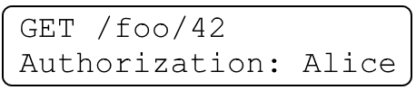
Identity / Authentication / Authorization
Identity: user data
Authentication: which user is this request for?
Authorization: is this request permitted?
Notes:
Subtitle is “A practical guide to API authentication” but actually talk about three different concepts: “identity”, “authentication”, and “authorization”.
Related but different – need to consider separately when making security decision.
Identity is your app’s concept of a user (Alice)
Authentication is process through which we securely associate identity w/ request (is it really Alice? Someone working on her behalf?)
Authorization is process through which we validate IDENTITY’s PERMISSION to perform
Just because a request is authenticated doesn’t mean its authorized, and just because a request is authorized doesn’t mean its authenticated. We’ll talk about that when we get to oAuth

Slide 9
Identity / Authentication / Authorization
Not all APIs care about all 3 things
Access control often your app’s responsibility
Notes:
Not all APIs care about all of these things.
Google API key for IDENTITY = rate limiting
Twitter cares about all 3
Point is that before you can pick an authentication strategy, you need to understand what problems it needs to solve.
Lastly, no matter how you authenticate, your app will still be responsible for some amount of access control.
Your custom business rules are the only thing that can know for sure if Alice is allowed to view data for Foo #42.

Slide 10
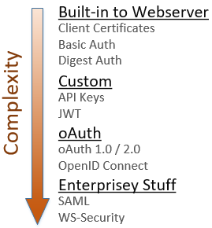
Notes:
So, how do you authenticate and secure your API endpoints? Here are the things I’ll be discussing today:
* Standards-based things directly supported by your web server, require very little code
* Custom implementations require more code, provide more flexibility
* Different flavors of oAuth and how they relate to OpenID Connect
* Time permitting, I'll talk briefly about SAML
Again, this session is not a tutorial on how to integrate these into your app. I just want you to understand at a high level how each of these things works.

Slide 11
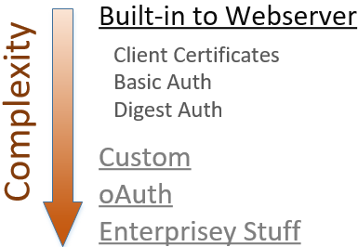
Notes:
The simplest way to secure your API is to use the authentication features built directly into your web server platform.
These 3 solutions are standards-based, are supported by all major web servers, and using them generally requires very little custom code. If you need something quick and dirty, start here.

Slide 12
Client certificates
“Reverse TLS” – proves client identity to server
No usernames or passwords
Ideal for internal apps, not public facing
On IIS, only “simple” w/ Active Directory
Notes:
The 1st of those techniques is “client certificates” = “reverse TLS”. In TLS, cert on server proves identity to client.
Client certs do the same thing, but in reverse. You install the certificate on your browser, and it proves your identity to the server and allows the server to verify that the request hasn’t been modified in transit.
No login screens, no redirects, every request instantly authenticated.
Drawbacks:
1) all users have to install security certs. Doesn’t scale.
2) Secondly, when using IIS, this is only a “simple” approach when authenticating against Active Directory because the tooling to link a client cert to a specific identity is built into Windows. If you want to authenticate against your custom user database it’s definitely possible, it just takes some more work.
These drawbacks mean that client certs are best suited for internal APIs on a secure network

Slide 13
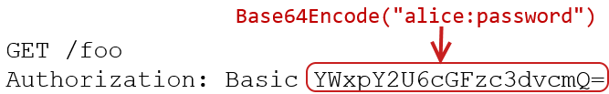
HTTP Basic Authentication
Notes:
If you don’t want to deal with client certs, the next simplest approach is HTTP Basic Authentication.
* Internet standard, supported by all major browsers, easy
* Username and password are concatenated together and Base64 encoded and sent with each request as a header

Slide 14

HTTP Basic Authentication
Notes:
When the server receives the request, it Base64 decodes that string back into its original format and parses out the username and password which are then used to authenticate the request.
Remember that Base64 encoding is not encryption, so the server doesn’t need any special keys to convert this back into the account credentials. But since this header is being sent over the wire with every request, you must use TLS to secure every single connection when using Basic Auth. It also means you’re only as secure as the underlying TLS implementation; if TLS gets cracked, like SSL did before it, these credentials are at risk of being stolen.
Note that the “Authorization” header is poorly named. This is authentication, not authorization.

Slide 15
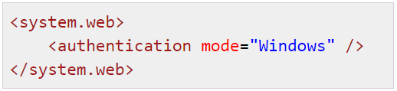
HTTP Basic Authentication
Active Directory supported “out of the box” on IIS
Easily authenticate against custom database (ASP.NET, WebAPI, OWIN)
Notes:
Setting up Basic Auth is really easy. If you’re using IIS, you get authentication against a Windows domain “for free” with a simple web.config setting.
For a public-facing website you’d probably want to authenticate against your custom user database. Most platforms make that very easy to do. For example, in ASP.NET or WebAPI you can write a tiny bit of middleware and override a few methods to provide the custom database queries that are needed.

Slide 16
HTTP Basic Authentication - drawbacks
Couples API calls to primary account password
Notes:
Basic Auth is very easy, but has two main drawbacks:
First, using the primary account password to authenticate API calls means that if the user changes their password it will break all of the API clients, and there's no way to revoke access from one API client without impacting all of them.
This means that if your API calls get compromised in any way, and if your users use the same credentials on multiple websites, then you’ve potentially led to them being compromised elsewhere.

Slide 17
HTTP Basic Authentication - drawbacks
Couples API calls to primary account password
Credentials passed as clear text – requires TLS
Notes:
Secondly, encoding is not encryption. These credentials are being passed in what is basically clear text, which means you MUST use TLS on all requests.
There's a way around this second drawback, and it's called Digest Auth. The main difference is that with Digest, the password is never sent over the wire, so there’s less risk of it being compromised.

Slide 18
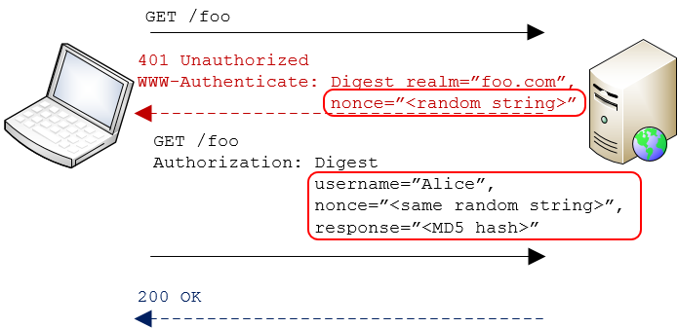

HTTP Digest Authentication
Notes:
Here's how Digest Auth works:
Clients makes a secured request
Server responds “not authorized” & includes a “nonce”

Slide 19
HTTP Digest Authentication
Notes:
The client then concatenates the username, password, and nonce together, and creates an MD5 hash of the result.

Slide 20
HTTP Digest Authentication
Notes:
Client then resubmits request, passing the username, the nonce, and computed hash value in clear text in a header.
The password itself is not sent over the wire.

Slide 21
HTTP Digest Authentication
Notes:
Server then takes the username, looks up the user’s password, re-calculates the hash, compares it to what client sent
Only way hashes match is if client and server used same password to calc hash == proof of identity

Slide 22
HTTP Digest Authentication
Easily integrates w/ other standards-based systems
TLS not required
Notes:
Just like with Basic Auth it’s very easy to integrate with systems that support the standard.
And since the password itself is never sent over the wire, you can safely use Digest Auth without a secure connection. At worst, an attacker would see the username. The nonce is garbage data, and the hash can't be reverse engineered back into its original form.
However, there are two significant drawbacks to using Digest authentication. The first is that MD5 has been broken, so those hashes aren’t as secure as we’d like.
There’s another issue too – so just to see if you’re awake, can anyone guess why Digest is not used very much any more?

Slide 23
HTTP Digest Authentication
Easily integrates w/ other standards-based systems
TLS not required
Prevents storing passwords with strong encryption!
Notes:
The biggest issue with Digest authentication is that it prevents the use of strong password encryption in your database! This is because the server must be able to take a username and obtain its plain text password in order to verify the hash.
But the whole point of modern password security is to make this impossible! The use of any one-way encryption method, such as salting and hashing passwords, will prevent you from using Digest Authentication.
Because of this issue no one really uses Digest for API authentication. But it’s important to understand the concepts behind using hash values to avoid sending sensitive data over the wire because those patterns are going to come up again and again.

Slide 24
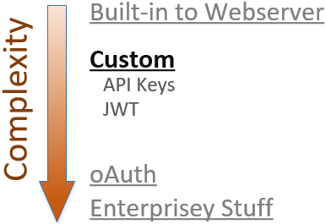
Notes:
Those 3 things work great if you want the API client to present actual user credentials during authentication, and if you’re OK with the constraints those techniques include. But what if those constraints are too limiting?
If you need more flexibility, either in terms of what information you use to authenticate OR how that information is transmitted, then the next simplest approach is to implement a custom scheme using API Keys or JSON Web Tokens.

Slide 25
API Keys
Use something other than primary account credentials as proof of identity
Notes:
Let’s talk about API Keys first.
The idea here is that it's generally more secure and more flexible to use something other than the primary credentials to authenticate an API call.

Slide 26
API Keys
Use something other than primary account credentials as proof of identity
Unique, random, site-assigned
Notes:
There's no "standard" of what an API key should look like, but in most cases they are GUIDs or some other long, random, unique string.
It's also important that these be assigned by you, rather than chosen by the client. By assigning the keys yourself you can ensure they are unique, and if one of those keys does get compromised there's no chance that the attacker can take it to another API and use it to authenticate as the same user.
There are two different ways to use API keys for authentication…

Slide 27
API Keys as "bearer tokens“
Pass the key in plain text with each request
Anyone that has the key, gets access; requires TLS to keep safe!
Notes:
The simplest approach is to treat the key like a password and pass it over the wire with every request. This is basically the same as Basic Auth, but you're passing an API Key instead of an encoded username and password
This is called a "bearer token" because anyone that has that API Key may use it to authenticate as a specific user; there's no additional security.
And since you're passing the raw account credential over the wire, you MUST use TLS on all requests to keep it secure.

Slide 28


API Keys as "bearer tokens“
Via querystring (using TLS)
Via header (using TLS)
Notes:
You can pass the API Key in either the querystring or an HTTP header.
Querystring really easy to do - ideal for scripting scenarios.
Generally headers are better
Header is more secure – not in log files. Wouldn't want plain-text passwords to be stored in unencrypted log files
Header can’t be leaked via copy/pasting a URL out of Fiddler or the browser's URL bar.

Slide 29
Trade-offs when storing bearer tokens
You can have secure storage of API Keys
–or –
the ability to show users a list of their keys.
Not both!
Notes:
Using API Keys as bearer tokens is very easy, but there is one significant trade-off you need to think about. You can either have secure storage of API Keys or the ability to show users a list of their keys. Not both.
Since API Keys are basically account passwords, you should consider salting and hashing them when you store them in the database. If you store them as text, and someone were to get access to your database, they would gain access to everything they need to impersonate every user in your system.
But if you salt and hash the API Keys when you store them, it will prevent you from showing a user a list of their API Keys. That’s kind of the whole point; you want your system to be able to verify a bearer token API Key, but not decrypt it to plain text, just like with passwords.
If you decide to store these things as plain text, then you should at least implement an expiration policy to limit the vulnerability window if the database is compromised.

Slide 30
API Keys as cryptographic keys: HMAC
Custom version of Digest Auth, using API Key instead of password
Does not prevent secure password storage
Notes:
The other way to use an API Key is to use it as a cryptographic key to sign the HTTP request.
This is basically a custom version of Digest Auth, but we use an API key to sign the request instead of a password. This way the primary password can be properly encrypted at rest.

Slide 31
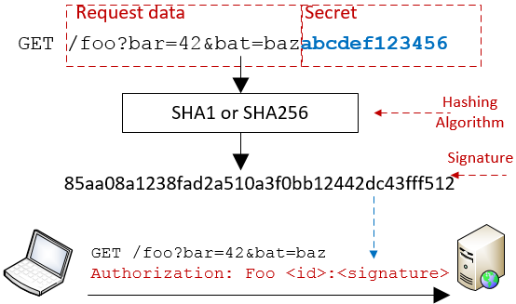
Notes:
Here's how signing works with API keys:
Client prepares the message which is either a URL or form post
Client concatenates the message with the API Key & runs result through a hashing function = signature
Client sends original message to the server, plus signature in a header
Server looks up client's API key and repeats hashing operation
If they match, server knows that client used same API Key, which is proof of identity.
The authorization header is type of “message authentication code”, or MAC. Since this technique uses a hash it’s called a “hash-based message authentication code”, or HMAC.

Slide 32
API Keys as cryptographic keys: HMAC
Credentials not sent over the wire
Server knows message wasn't changed in transit
Notes:
HMAC has a lot of benefits.
First, no credentials are sent over the wire, so there's less risk of them being stolen. As a result, this does not require TLS. If the request itself is sensitive then you should still use TLS, you just don't need it to keep the credentials safe.
Secondly, unlike with bearer tokens, the server can guarantee that the message contents themselves were not modified in transit. This is because the URL parameters and form data are used to create the signature. If a middleman manipulates those values in any way, then the server will calculate a different hash value then the client provided.

Slide 33
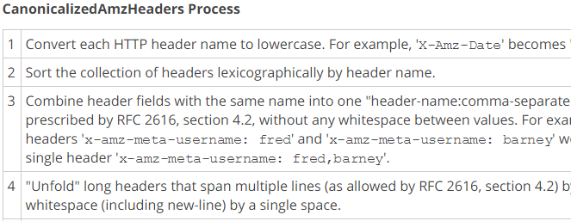
HMAC Drawbacks
Client and server must compute hash exactly same
Notes:
The primary drawback to HMAC is complexity.
* Client and server must compute the hash EXACTLY the same way.
* Usually requires publishing detailed instructions that describe how to “canonicalize” the request data
This image is a tiny piece of just one portion of instructions for canonicalizing an AWS API call.
* Client and server must agree on which headers to include. If middleware network component adds a header to the request, server will calculate different signature.
This complexity is a necessary part of using HMAC. It’s the price you pay for the increased security that signed requests provide.

Slide 34
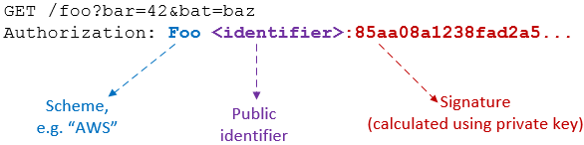
Signed requests using HMAC
Notes:
In order for signing to work, the request must include at least two things:
The signature created with the API Key
A pointer to the identity that owns the API Key used to create the signature
Identity indicator is required so server can look up the API Key that it needs to verify the signature.
This means that if you build an HMAC system you’ll have to choose what to use as the identifier and what to use as the secret value.
You could use the user's ID or email address as the identifier, but that makes it harder to support multiple API keys for a single user. The server needs a way to determine the specific API key the client used to sign the request. If you pass the user ID as this identifier, and that user is associated with multiple API keys, then you'll have to compute multiple hashes to verify the request.
A better approach is to issue API Keys as a pair – one public key, that's sent over the wire in plain text as the identifier, and a private key that's used in hashing.

Slide 35
HMAC: API Key storage
Must be something app can retrieve in clear text
Add expiration timeout if necessary
Notes:
Remember that to do request signing, API Keys must be stored in plain text or using reversible encryption. App needs it to verify sig.
Storing in text means it can be compromised if an attacker gains access to your database. To combat this, implement an expiration policy for your API Keys

Slide 36
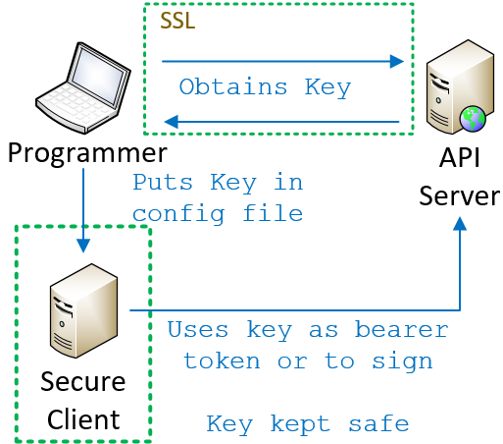
API Keys: Great for server-based clients
Notes:
The last detail of an API Key implementation that you need to think about: how does the client come to know the key in the first place?
Regardless of whether you’re using bearer tokens or HMAC, the client must know the secret value. That knowledge is the key to authentication taking place.
If you’re writing a server-based client it’s easy.
* Programmer obtains the secret value using some secure mechanism * Puts it into the source code or config file for the client.
The client is secure, so as long as you’re either using bearer tokens and TLS or HMAC, the key itself is never exposed.

Slide 37
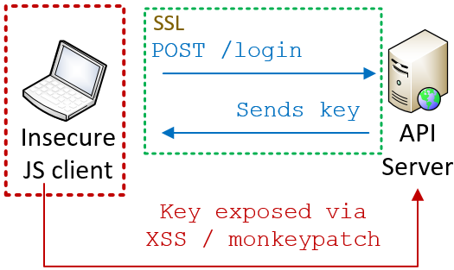
API Keys: Less great for JS clients
Notes:
More complicated for a JS client. No way to pre-load key up front; users can log in from any browser
You could require user to actively authenticate by logging in. Then, send API key back to client
Problem is client cannot securely store the key – JS is not secure env. Crypto functions can be monkey patched, local storage susceptible to XSS
Assume that anything you expose to JS is open for inspection
So if we can’t store the API keys in JS, how do we secure an API for a JS client?

Slide 38
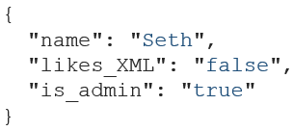
JWT: Secure tokens for JS clients
Open, industry standard method for securely representing claims between two parties
Notes:
One answer is JSON Web Tokens, pronounced “JOT”.
JSON Web Tokens are an open, industry standard method for securely representing claims between two parties.
“Claims” are nothing more than pieces of data; they might be demographic such as a name, they might be user preferences, or they might be statements about what the user is allowed to do in the system. And since this standard is called “JSON” Web Tokens, the claims are obviously expressed using JSON.
Once those claims are generated, the server cryptographically signs the claims just like we saw with HMAC and creates a token. It gives that token to the browser, and the browser resends the token back to the server with each request. The server then validates the token and then uses the claims as needed, for instance to perform authorization.

Slide 39
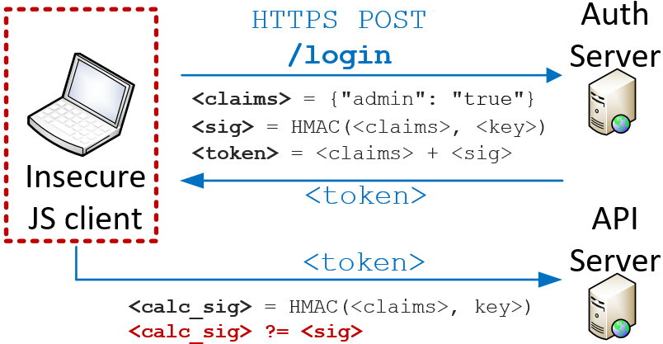
JWT: Secure tokens for JS clients
Notes:
Let’s walk through that again in a little more detail.
Using JWT, the user still needs to securely authenticate themselves by logging in. We still need some way to securely authenticate the user behind the JS client.

Slide 40
JWT: Secure tokens for JS clients
Notes:
Once the server validates the credentials, it creates a JSON document indicating that the user has authenticated and specifying the permissions they have in the system.
Those claims are encoded as JSON.

Slide 41
JWT: Secure tokens for JS clients
Notes:
Using a secret key known only to the server, the claims are hashed to create a signature.

Slide 42
JWT: Secure tokens for JS clients
Notes:
Finally, a token is created that contains both the claims (in plain text) and the signature. This token is sent back to the client.

Slide 43
JWT: Secure tokens for JS clients
Notes:
From there, the client re-submits the token with every subsequent request.

Slide 44
JWT: Secure tokens for JS clients
Notes:
Upon receiving a request that contains a token, the server extracts the claims and then re-computes the signature.
If the calculated signature matches the signature in the token, then the server knows the claims are valid; they could only have been signed by someone in possession of that private key. If the claims in the token had been modified in any way the signature wouldn’t match.
Again, this is very similar to signing API keys, except in this case only the server knows the secret key. The client’s job is just to store and re-submit the token.
And if the token passes validation, the server knows it can trust the claims.

Slide 45
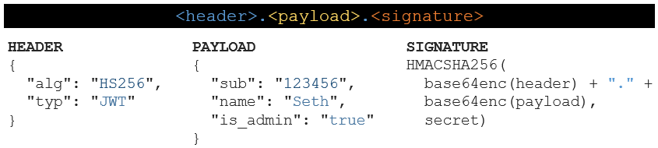

Format of a JWT token
Notes:
JWT tokens consist of 3 pieces of data, separated by a period.
First is a standard header that typically indicates the type of token and the hashing algorithm being used. In this example we’re using HMAC SHA256, but other options exist.
In fact, the ability for the client to choose which hashing algorithm should be used is a core piece of the JSON Web Token standard. It's also one of the reasons that some security experts don't like JWT, although a discussion of those concerns is out of scope for this talk.

Slide 46
Format of a JWT token
Notes:
The second piece of data is the payload, which contains the actual claims you’re making.
The JWT spec defines a handful of predefined claims called “registered claims”. These are optional but are recommended if you want your tokens to be more easily used between disparate systems. For instance, in this example here I’m using the “subject” claim to represent the ID of the user that logged in.
In addition to those predefined claims you can also create private claims to fit your own needs. In this example “name” and the “is_admin” flag are private claims.

Slide 47
Format of a JWT token
Notes:
The third piece of data is the signature, which is calculated by combining the header and payload together and then running them through the hashing function.

Slide 48
Format of a JWT token
Notes:
Finally, the base64-encoded header, the base64-encoded payload, and the signature are all concatenated together with periods, resulting in the final token.
This string right here is what gets sent back to the browser, and is then echoed back to the server on subsequent requests, usually in an Authorization header.
The really cool thing about this is that these claims make JWT tokens self-contained and stateless; rather than just saying “the user ID is 12” and relying on the server to figure out what permissions user 12 has, the JWT token itself can state those permissions. This can really help with performance because everything the server needs for authentication and authorization can be contained directly in the token, avoiding the need for additional database lookups to authorize a request.

Slide 49

Format of a JWT token
Claims are visible to client!
Notes:
It’s important to note that even though the token looks like gibberish, the header and payload are encoded but not encrypted. This means that anyone that gets access to that token will be able to read the claims that it contains.
This brings up some interesting trade-offs regarding where you store the token between requests, and what sort of access your JS code has to it.

Slide 50
Storing JWT on the JS client
Don’t put tokens w/ sensitive data into LocalStorage!
 | Safe from XSS? | Safe from CSRF? | App can access token payload?
LocalStorage | ✗ | ✓ | Yes
httpOnly secure cookie | ✓ | ✗ (easy to address) | No
Notes:
Once the server sends your JS client a JWT token, you can either store it in LocalStorage or in a cookie.
The advantage of LocalStorage is that your JS code can access the claims. This is useful if those claims contain data that you need the app itself to have access to. The downside is that information stored in LocalStorage is vulnerable to cross-site scripting attacks, so you should only store tokens there if the payload doesn’t contain sensitive values.
Alternatively, you could put the token into an httpOnly secure cookie. This way, the token is protected in transit by TLS, and is also protected against XSS. However, the claims themselves will NOT be visible to Javascript. That means that the token can only be used for server-side authentication and authorization.

Slide 51
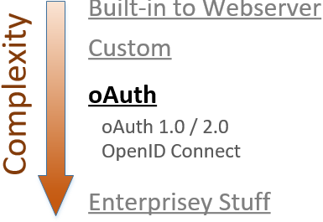
Notes:
At this point we’ve discussed some simple authentication schemes supported natively by the web server itself and we’ve discussed custom systems based around API Keys and web tokens. Next on the agenda is Oauth.
OAuth builds on many of the concepts we just saw, but it’s a definite step up in complexity.
We’re going to discuss a few different things: the difference between 2- and 3-party authorization, the differences between OAuth versions 1.0 and 2.0, and what it means for OAuth to be an authorization framework, not an authentication one.

Slide 52

Client/server authentication (2-legged)
Client is resource owner; access its own data
Notes:
OAuth was originally designed to solve the problem of “delegated authorization” in a 3-party scenario.
To explain that, let’s first review the traditional 2-party scenario you see here.
Client uses ITS credentials to access ITS resources on the server. In OAuth parlance, this is a “2-legged” model because there are two entities involved. One scenario that uses this model is server-to-server communication.

Slide 53
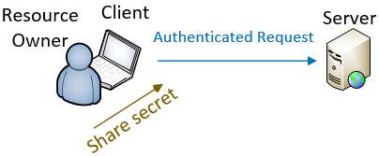
Delegated authorization (3-legged)
Client acts on behalf of the resource owner
Notes:
In other cases, the client is acting ON BEHALF OF another entity.
In those cases, client is not accessing its own resources but those of the end user.
One way to do this is for the user to share their credentials with the client so that the client can use them to make the authenticated request.
That’s fine if I trust the client, and I don’t mind the client impersonating me when it talks to the server.

Slide 54
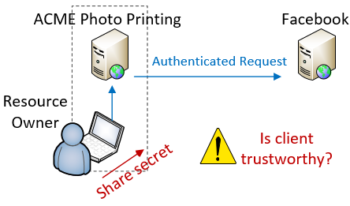
Delegated authorization (3-legged)
Notes:
But what if I DON’T trust the client with my credentials?
Let’s say I have some photos that I've uploaded to Facebook and I want to use the ACME Photo Printing website to create greeting cards using those photos.
I could give ACME my Facebook password, and it could then make an authenticated request to FB’s APIs. In this case, FB would think it was me accessing the data.
But the thing is, I don’t want to give ACME my FB password. So how else is it supposed to get access to my photos?

Slide 55
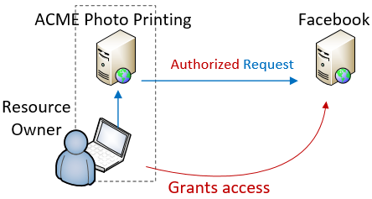
Delegated authorization (3-legged)
Notes:
This is the exact scenario that OAuth was designed for.
“3-legged” model because there are 3 parties involved: the Resource Owner that owns the content (me), the Service Provider that hosts the content (FB), and the Client that accesses the content.
OAuth allows me to authorize ACME to access my FB photos, but without sharing my actual credentials.
When I do this, ACME is no longer making an AUTHENTICATED request, its making an AUTHORIZED request. We’ll talk about this in a minute.

Slide 56

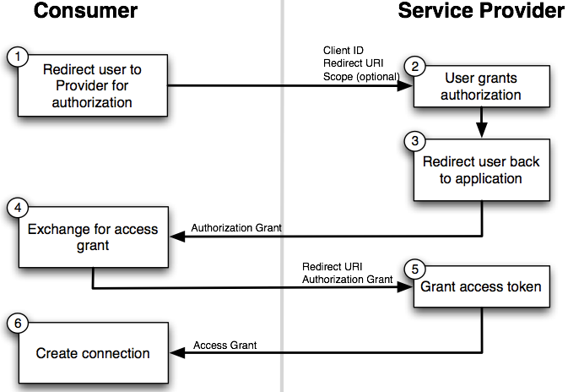

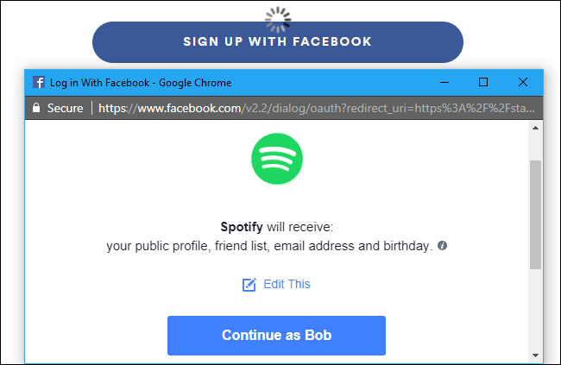
Notes:
Here’s how it works. The user starts out on the client’s website, ACME photos. ACME redirects the user to the provider (Facebook)
The user first authenticates themselves to Facebook
Facebook displays a page to the user to collect authorization, which looks like this

Slide 57
Notes:
This page is hosted by the authorization server, which presumably you trust. It explains the sorts of access that you are authorizing.
If you choose to authorize the access, the OAuth flow continues.

Slide 58
Notes:
User authorizes the access ➔ redirects back to the client with an “authorization grant”.
Client makes another call to service and trades auth grant for an access token
transition
* There are 2 versions of OAuth and they solve this problem in very different ways
* Not universally accepted that the newer version is best

Slide 59
OAuth 1.0a
Uses signed requests (TLS not req. / integrity guaranteed)
Best with web-based clients
Complex to implement – use libraries!
Notes:
OAuth 1.0 uses signed requests.
Does not require TLS
Message integrity is guaranteed
Works best w/ web-based clients b/c user must be sent to a website to do the auth
Primary drawback complexity from signing
Mitigated a little by libraries, but still a lot of work

Slide 60
OAuth 2.0
No HMAC signatures == simpler to implement
Better support for enterprise & non-web clients
Not backwards compatible with 1.0/1.0a
Notes:
OAuth 2.0 was designed to be simpler and to better support non-web clients. It is an entirely different implementation and the two are not compatible.
In technical terms, Oauth 2 uses bearer tokens instead of request signing. This makes it easier to implement, but you must use TLS and you lose the ability to guarantee that a message wasn't modified in transit.
OAuth 2.0 also supports more "flows" than 1.0 which makes it a better fit for some enterprise use cases.

Slide 61
OAuth 2.0 – drawbacks
OAuth 2.0 is a framework, not a protocol; less interoperable than 1.0a
Notes:
It’s important to note that the 2.0 spec is considered a framework rather than a protocol.
In order to support the wider range of authorization workflows, many decisions are left to implementers
This hurts interoperability.
Two providers may say they are OAuth 2 compliant, and have very different actual implementations
Code you write for one provider may require a lot of work to support a different provider

Slide 62
OAuth 2.0 – drawbacks
OAuth 2.0 and the road to Hell
“When compared with OAuth 1.0, the 2.0 specification is more complex, less interoperable, less useful, more incomplete and, most importantly, less secure.”
Eran Hammer, former lead author of OAuth working group
http://hueniverse.com/2012/07/26/oauth-2-0-and-the-road-to-hell/
Notes:
There’s some controversy around 2.0 as well.
Eran Hammer was the lead author for the OAuth working group
withdrew his name from the 2.0 specification prior to publishing
“OAuth 2.0 and the Road to Hell”

Slide 63
Use OAuth 2.0 if…
OAuth 2.0 and the road to Hell
“If you consider yourself a security expert, use 2.0 after careful examination of its features. If you are not an expert, copy an implementation of a provider you trust… or make sure you have some security experts on site to figure it out for you.”
Eran Hammer, former lead author of OAuth working group
http://hueniverse.com/2012/07/26/oauth-2-0-and-the-road-to-hell/
Notes:
He goes on to say “If you consider yourself a security expert, use 2.0 after careful examination of its features. If you are not an expert, copy the implementation of a provider you trust to get it right or make sure you have some security experts on site to figure it out for you”.
This might just be sour grapes or a difference in vision for OAuth.
Make sure you research before choosing OAuth 2

Slide 64
OAuth is not an authentication protocol!
Notes:
Let’s talk about authentication vs authorization again.
OAuth is a standard for delegating authorization to an API.
About you, as a Resource Owner, authorizing one application to access your data from another application.
It is not an authentication protocol and you should not be using Oauth to figure out WHO is making the request

Slide 65
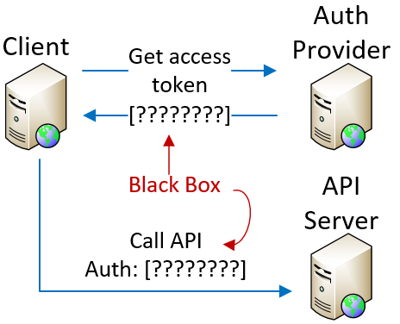
Access tokens are opaque - don’t provide ID
Notes:
That’s because OAuth access tokens don’t tell the client anything about user identity.
By definition, access tokens are opaque to the client. The client gets a token from the auth provider, and it uses the token to make API calls, but the token itself is a black box - client can’t parse it or extract data
Therefore, the access token can only tell us that the request is allowed. The token alone cannot tell us WHO is making the request, and there is no authentication without a “who”

Slide 66
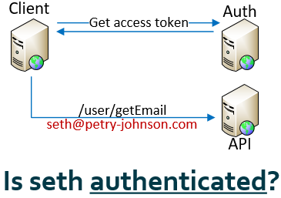
Access to identity API != authentication
Notes:
But what if the access token authorizes you to call an API that will provide the “who” associated with that token?
For instance, let’s say the token lets you call this “getEmail” API, which then returns the email address that owns the data that access has been granted to. Is that sufficient for authentication?
NO, because no guarantee that only that user was able to authorize that access. If more than one entity can delegate access to that identity API, then you can’t assume that your authorization is sufficient for authentication
This might be easier to understand with an example.

Slide 67
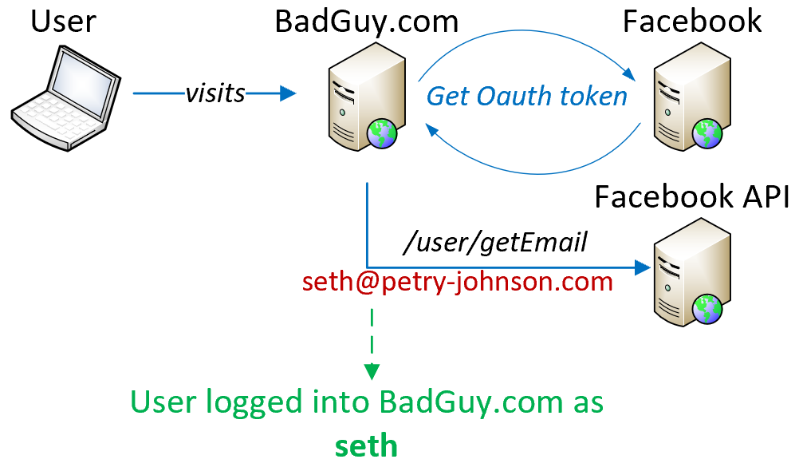
Access to identity API != authentication
Notes:
Let’s say there is a website called BadGuy.com that lets people “log in with Facebook”.
I go to BadGuy.com and, using the normal OAuth flow, I authenticate against Facebook and then authorize Facebook to give my profile data to BadGuy.com. This results in BadGuy getting an Oauth token that can access my data.
BadGuy.com uses token to call Facebook’s API and gets my email address, so they now know that the token grants access to my data
If I already have an account at BadGuy, they might go ahead and consider me logged in.
At this point, BadGuy has access to the email address associated with my FB account, and I have full access to my account at BadGuy.
So far, so good.

Slide 68
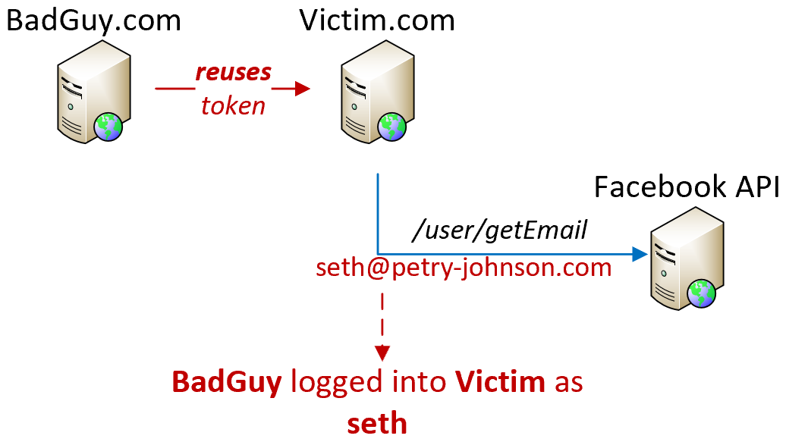
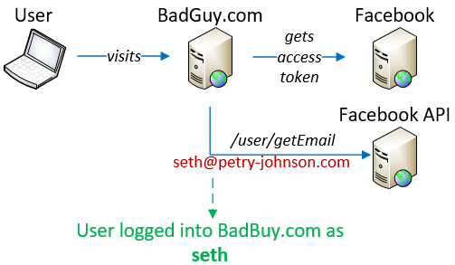

Access to identity API != authentication
Notes:
Now, shocker, it turns out that BadGuy.com isn't trustworthy. They go over to Victim.com, which also allows FB logins, but instead of going through the auth process, BadGuy.com pretends that they are being redirected back from FB and they reuse the access token they obtained earlier, when I authorized it.
So now, when Victim.com calls the API to get the related user data, they also get my email address back.
If Victim uses the ability to call that API as proof that it is ME on the line, then it will now have allowed BadGuy to log into my account.
Neither BadGuy nor Victim have more access to FB data than was authorized, but BadGuy now also has access to my data at Victim.
Possible because OAuth access tokens do not have audience restriction. This is a problem with bearer tokens in general; Victim has no way to know that it's being compromised.

Slide 69
Access token != authentication
DO NOT use resource authorization as proof of authentication
Notes:
To avoid that problem, ONLY use access tokens to access the authorized resource.
If you use possession of an access token as proof of authentication, you are vulnerable.
To solve this problem, the access token would need to include some additional stuff:
assert which client it was granted to and
which authenticated identity authorized it
IF the access token contained those things, then Victim would be able to identify when BadGuy was trying to hack it, and it would be able to use the access token as proof of identity as well as proof of authorization,

Slide 70
OpenID Connect
Open standard, built on top of OAuth 2.0
ID Tokens – gives authentication data to client
Audience restrictions
Enables authentication against 3rd party identity providers
Notes:
That’s the basic concept behind OpenID Connect.
Open standard that defines an interoperable identity layer on top of OAuth 2.0.
Allows authentication against 3rd party identity providers by closing some of the gaps we just mentioned.
ID Connect adds extra tokens which are given to client in addition to regular OAuth access token.
These have well-known format so the client can extract identity claims and audience restrictions directly from the token.
OpenID Connect replaces OpenID 2.0 and is the best way to implement something like “Log in with Google” on your app.

Slide 71
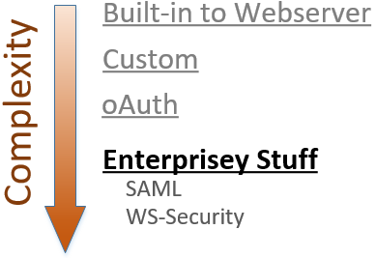
Notes:
To wrap up our review of authentication options I want to touch very briefly on two additional techniques that you might want to be aware of.
The first is SAML, which stands for “Security Assertion Markup Language”. It basically does the same thing as JSON Web Tokens, but uses SOAP and XML rather than JSON over HTTP. SAML is older and more complex than JWT, but it does offer some additional functionality. SAML is very commonly used for enterprise single-sign-on scenarios, although JWT is starting to see some adoption in this area.
The second is WS-Security, and honestly I don’t know much about it. If you’re dealing with very complex, enterprise-grade authentication scenarios then you might want to hire a security expert to help. It’s probably safe to say that nobody attending my 101-level intro to authentication systems has any business implementing WS-Security in PROD without a little help.

Slide 72
So what should you use?
Notes:
So, which of those options should YOU use for your own APIs?
Like most things in this industry, the correct answer to this question is “it depends”.

Slide 73
Choose your own adventure
Consider client certificates for…
Intranet logins against Active Directory, or
Other enterprise scenarios
Notes:
Client certificates are pretty easy to use, IF you can get your users to install them. They aren't a good fit for the public internet.
This is worth considering if you're securing a private API against Active Directory

Slide 74
Choose your own adventure
Consider HTTP Basic Auth for…
Authenticating server-to-server API calls against a standard database, like ActiveDirectory
Notes:
Basic Auth might be a good fit for server-to-server API calls against a standard user database such as ActiveDirectory. Just remember that you're passing the primary account credentials over the wire in plain text.

Slide 75
Choose your own adventure
Consider HTTP Digest Auth for…
Nothing. Don't ever do this.
Notes:
There’s no good reason to use Digest Auth. Anyone that tells you to do this is about 15 years out of date.

Slide 76
Choose your own adventure
Consider API Keys as bearer tokens for…
Rapidly standing up a new API;
Scenarios where simplicity is more important than security
Notes:
Using API Keys as “bearer tokens”, where you pass the key itself with each request, is really easy to implement so it’s great for rapidly standing up a new API when you don’t need top-notch security.
Just remember to use TLS for all requests.

Slide 77
Choose your own adventure
Consider signed requests using API Keys when…
You need extra security vs bearer tokens, and
You can thoroughly document the signing process
Notes:
If you want more security than you get with bearer tokens, then use API Keys to sign requests.
Remember that creating the signature can be complex and requires that the client and server create the hash in exactly the same way. The need to document and support the canonicalization process may make supporting 3rd party clients a pain, so this might be best when you’re writing both the client and server yourself.

Slide 78
Choose your own adventure
Consider JSON Web Tokens for…
JavaScript clients
A stateless alternative to in-memory "sessions"
Lightweight SSO
Notes:
JSON Web Tokens are definitely worth a look if you're writing a JS client.
These can also be useful for tracking state without "sessions" in server memory and for implementing lightweight SSO integrations.

Slide 79
Choose your own adventure
Consider OAuth 1.0a when…
You need to access user data, and
You only have web-based clients, and
You care more about security than complexity
Notes:
OAuth is a good fit if you need to support delegated access to user data.
You should consider the 1.0 version if you only need to support web-based clients and want maximum security.
Remember that the primary drawbacks with OAuth 1.0 are the complexity involved in making signed requests and limited support for non-browser clients, so make sure you’re prepared to deal with those things.

Slide 80
Choose your own adventure
Consider OAuth 2.0 when…
You need to access user data, and
You need to support a wide set of devices, or
You want to avoid complexity of signing
Notes:
If you need to support a wider set of devices and authentication flows, or if you care more about flexibility and simplicity than security, then OAuth 2.0 is a better fit than 1.0.
Just remember that OAuth 2 is a framework, not a protocol, and there may be big differences between different provider implementations.

Slide 81
Choose your own adventure
Consider OAuth 2.0 + OpenID Connect when…
You need to authenticate against 3rd party identity data
You want a robust SSO option, without SAML
Notes:
Remember that OAuth by itself is for authorization only.
If you want to authenticate against 3rd party data then use OpenID Connect on top of OAuth 2.0.

Slide 82
Choose your own adventure
Consider SAML or WS-Security if…
You find XML to be life-affirming and joyful, or
You have a Legit Reason To Do It The Hard Way ™
Notes:
Lastly, you should use SAML or WS-Security if you have a sick love affair with XML, or if you have one of the very complex scenarios that needs the extra complexity they entail.
If you’re creating an API for your own internal use, or for public use on the open internet, these things are overkill and you should stick to something simpler.

Slide 83
3 key things to remember
Use API Keys as bearer tokens (easy) or to sign requests (more secure)
JSON Web Tokens are a secure, stateless way to share non-sensitive data. Careful about XSS/CSRF!
OAuth is for authorization, not authentication. Use OpenID Connect if you need both
github.com/spetryjohnson @spetryjohnson / seth@petry-johnson.com
Notes:
Research shows that attendees of a talk such as this will only remember 3 things, so here are the 3 most important things I want you to take away.
* Use custom API keys as bearer tokens for a quick and easy approach, or to sign request using HMAC for additional security. * JSON Web Tokens are a secure, stateless way to share non-sensitive data. Be careful about cross-site scripting or cross-site request forgery. * Lastly, OAuth is for authorization, not authentication. Use OpenID Connect if you need both.
These slides and my narrative are all up on GitHub if you’d like to refer to them later.
Finally, please take the time to provide some feedback for this session in the mobile app, or you can also reach out to me directly on Twitter or email. I really do want to hear your feedback, good and bad, so that I can keep improving this session.
THANK YOU!

